Slide 1
Zagreb Film Studio
FILM344 – Group Presentation
Russ Austin
Trevor Bena
Peter Carta

Slide 2
History
Zagreb Studios is a Croatian based film company started in 1953 in Yugoslavia
1920-1950 – Due to long tradition of art in Croatia, many attempts were made at animation
Many attempts, but no known success
1949 – A group of caricaturists lead by Walter Neugebauer and Fadil Hadžić began work on the first independent animated film in Croatia.
Worked on it for 1 year. 20 minute animation
The Big Meeting

Slide 3
History
After seeing the success of the film the Yugoslavian government began funding production
Duga Film (Rainbow Film)
Began training new drawers, animators, inkers, painters, backgrounders and other specialists,
Isolated from the west. Self taught from mail ordered textbook from United States
Produced 5 animated films before government stopped funding in 1952 because of bad economy due to Isolation from Soviet and Western world

Slide 4
History
1953 – Croatian Union of Film establishes Zagreb Film Co.
Worked on several different categories of film
Distribution and Production of both short and feature length films
Started with commissioned and commercial films
Specialized in documentaries and short feature films
1956 – Formed Studio for Animated Films
This division is where the studio gained fame

Slide 5
History
Rainbow Film group joined with the newly formed studio
Attracted many members
Late 50’s - Early 60’s – Many independent films produced, led to international success of Zagreb School of Animated Film
Produced many independent films and 4 animated series’: Hound for Hire, Inspector Mask, Professor Balthazar and The Little Flying Bears.
Professor Balthazar had great success world wide

Slide 6
Communist Influences
Produced films in the “reduced animation” style
Characterized by simple shapes and backgrounds
Would use 4000 frames where a western studio would use 15,000 frames
Held back by lack of modern technology and materials
Funding was dependent on government central economic planning
Subject matter had to be acceptable to the Communist Party
Members turned down offers to move production to west

Slide 7
Post Croatian War of Independence
Zagreb stopped production with the fall of communism because of the 5 year Croatian War of independence
Lost subsidies from communist government
They were reformed in 1995 by the City of Zagreb. now do contract animation and custom animation
Difficult to License work since Communist government made long term contracts

Slide 8
Awards
1962 - American Academy Award for the animated film The Ersatz
- First non-American to win an Oscar (Dušan Vukotić)
Nedeljko Dragić’s Tup-Tup and Zlatko Grgić’s Dream Doll nominated for Oscars
Over next 30 years the studio and it’s artists won many international awards and recognitions (about 500)

Slide 9
Main Contributions
Educated people on the possibilities of Animation
Zagreb School of Animation
trained many artists
Most animations are independent
Animators do mostly what they choose to do
World Festival of Animated Film (Animafest)
Festival dedicated to the art of Animation
Main Competition, Student Films Competition, Children Films, Educational Films, Commercials, Music Videos and Films Made for the Internet

Slide 10
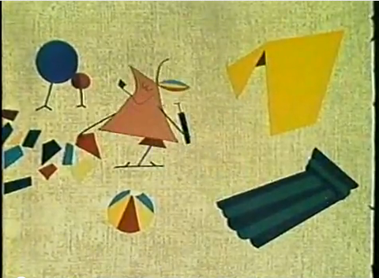
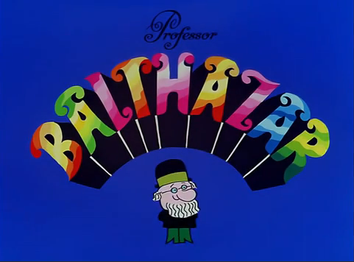
Animation Examples
The Ersatz (1961) Lighthouse Keeping (1969)
http://www.youtube.com/watch?v=xQyKaPQ6Abs
http://www.youtube.com/watch?v=XpgnKoavZ8o&feature=related

Slide 11
Sources
http://www.zagrebfilm.hr/index_e.asp
http://en.wikipedia.org/wiki/Animafest_Zagreb
http://en.wikipedia.org/wiki/Professor_Balthazar
http://w3.fh-wuerzburg.de/petzke/zagreb.html

